Slide 1
Project Analysis and Evaluation
Project Analysis and Evaluation is a systematic process of assessing whether a proposed project is feasible, viable, and aligned with organizational objectives before committing significant resources.
Project analysis and evaluation are not named as a single process, but they are embedded across multiple knowledge areas and process groups, mainly during Initiating, Planning, Monitoring & Controlling, and Closing.
They focus on:
Analyzing whether a project is viable, aligned with business goals, and feasible
Evaluating project performance, progress, and outcomes against baselines and objectives

Slide 2
Project Analysis - Business Case Analysis
Business Case Analysis (Initiating Process Group)
Purpose: To justify the project from a business perspective.
Key Questions:
Why is this project needed?
What value will it deliver?
Do benefits outweigh costs?
Includes:
Cost–benefit analysis
Market demand
Strategic alignment
Risk vs reward
Example:
A bank wants to develop a mobile banking app.
Estimated cost: ₹2 crore
Expected benefit: ₹6 crore in 3 years
Strategic goal: Increase digital customers
👉 Since benefits exceed costs and align with strategy, the project is approved.

Slide 3
Project Analysis - Feasibility Analysis
Evaluates whether the project is practically achievable.
Types of Feasibility:
Technical feasibility
Financial feasibility
Operational feasibility
Legal feasibility
Schedule feasibility
Example: A hospital plans to implement an AI-based diagnostic system.
Technical: Do we have AI expertise? ✔
Financial: Budget available? ✔
Legal: Complies with medical laws? ✔
Schedule: Can it be done in 12 months? ❌
👉 Schedule risk identified and addressed before approval.

Slide 4
Project Analysis - Stakeholder Analysis
Identifies stakeholders and analyzes:
Power
Interest
Influence
Expectations
Tools:
Power–Interest Grid
Stakeholder Register
Example: For a highway construction project:
Government: High power, high interest
Local residents: Low power, high interest
Contractors: High power, medium interest
👉 Communication strategies are planned accordingly.

Slide 5
Example – Power-Interest Grid
Software Project Scenario (Assumption)
Project Title: Online Learning Management System (LMS) Development Organization: ABC Technologies Project Objective: Develop and deploy a web-based LMS for a university within 8 months.
Power–Interest Grid
The Power–Interest Grid classifies stakeholders based on:
Power: Ability to influence project decisions
Interest: Level of concern or involvement in project outcomes
PMBOK defines four quadrants:
Manage Closely
Keep Satisfied
Keep Informed
Monitor

Slide 6
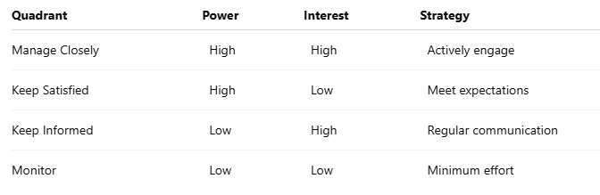
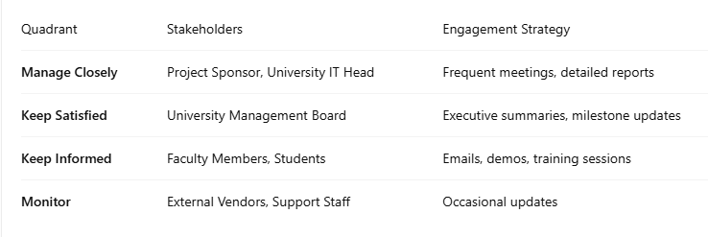
Example

Slide 7
Example – Stakeholder register
Identifies all project stakeholders and captures relevant information regarding their interests, influence, involvement, and impact on the project.
The stakeholder register is needed to:
Identify all stakeholders early
Prevents missing critical stakeholders
Understand stakeholder expectations
Helps avoid conflicts and misunderstandings
Assess influence and impact
Enables prioritization of stakeholders
Plan communication and engagement
Supports development of the Stakeholder Engagement Plan
Support decision-making
Helps the project manager manage approvals, resistance, and support
Reduce project risks
Unmanaged stakeholders are a major cause of project failure

Slide 8
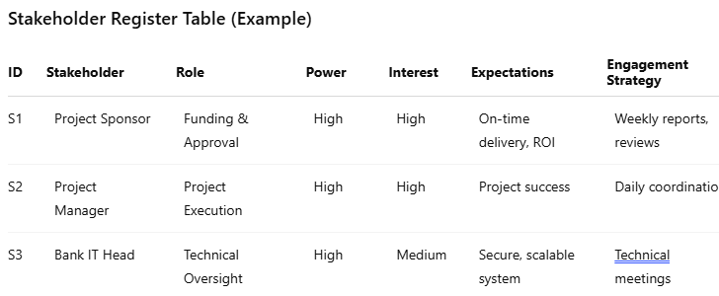
Example – Stakeholder Register
Components of a Stakeholder Register
Stakeholder Identification Information
Stakeholder Assessment Information
Stakeholder Assessment Information
Power (High / Medium / Low)
Interest (High / Medium / Low)
Influence
Impact on project success
Attitude (Supportive, Neutral, Resistant)
Stakeholder Classification
Internal / External
Supporter / Neutral / Opponent
Power–Interest category
Engagement strategy

Slide 9
Project Analysis - Risk Analysis
Identifies and analyzes uncertainties that may affect project objectives.
Types:
Qualitative Risk Analysis (probability & impact)
Quantitative Risk Analysis (numerical impact)
Example: In a software project:
Risk: Key developer may resign
Probability: Medium
Impact: High
👉 Mitigation: Cross-training team members.

Slide 10
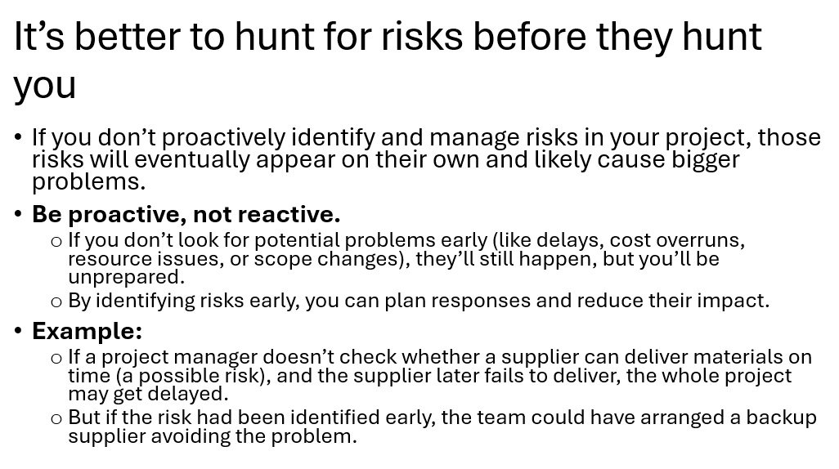

Slide 11
Risk Management
Risk is an uncertain event or condition that, if it occurs, has a positive or negative effect on one or more project objectives such as scope, schedule, cost, quality, or performance.
Key points:
Risk is about uncertainty
It may have negative effects (threats) or positive effects (opportunities)
Risks exist in all projects, especially IT projects
Characteristics of Risk
Future-oriented
Uncertain in nature
Has a cause and an effect
Can impact cost, time, quality, scope, or reputation
Can be managed but not completely eliminated

Slide 12
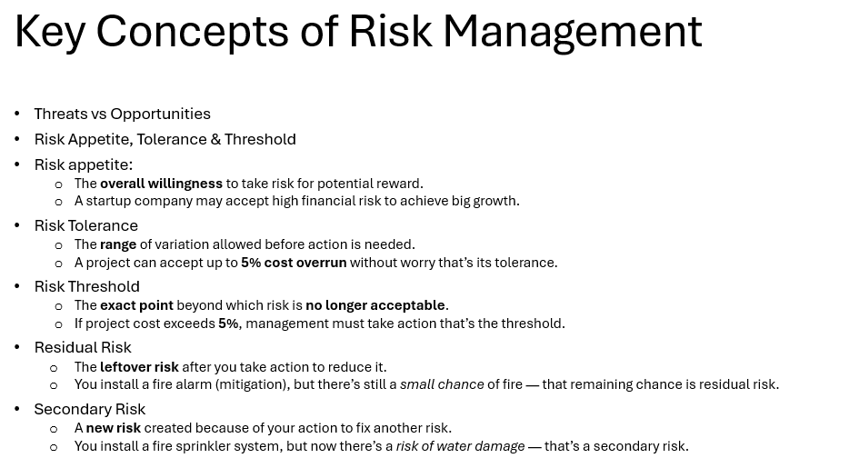

Slide 13
Risk Managment
Types of Risk
Based on Impact
Negative Risk (Threat)
Events that can harm the project.
Example (IT Company):
Cybersecurity breach delaying software release
Key developer resigns during critical phase
Positive Risk (Opportunity)
Events that can benefit the project.
Example:
Use of a new automation tool reduces development time
Client requests additional features with extra payment

Slide 14
Types of Risk in IT Projects
Technical Risk
Risks related to technology, tools, or systems.
Examples:
New programming framework is unstable
Integration failure between legacy system and new software
Project Management Risk
Risks related to planning, scheduling, and control.
Examples:
Poor effort estimation
Inadequate communication among teams
Unrealistic deadlines

Slide 15
Types of Risks in IT Projects
Business / Organizational Risk
Risks related to organizational environment.
Examples:
Change in company strategy
Budget cuts from management
Client organization restructuring
External Risk
Risks outside the organization’s control.
Examples:
Changes in government IT regulations
New data privacy laws (GDPR)
Vendor failure

Slide 16
Types of Risks in IT Projects
Resource Risk
Risks related to human or material resources.
Examples:
Skilled developers not available
High employee attrition rate
Dependency on a single expert
Security Risk
Very critical in IT projects.
Examples:
Data theft
Malware attacks
Unauthorized access

Slide 17
Why Risk Needs to Be Managed
Risk management is essential because:
Prevents project failure
Reduces cost overruns
Avoids schedule delays
Improves decision-making
Increases chances of project success
Improves stakeholder confidence
Helps identify opportunities
Example: Early identification of performance risk in a cloud application helps allocate better infrastructure, avoiding customer complaints later.

Slide 18
Types of Risk Management (Risk Response Strategies)
Strategies for Negative Risks (Threats)
Risk Avoidance
Eliminating the risk completely.
IT Example:
Avoid using an untested technology
Cancel a high-risk feature
Risk Mitigation
Reducing the probability or impact of the risk.
IT Example:
Conduct code reviews to reduce defect risk
Provide training to reduce skill gap

Slide 19
Types of Risk Management (Risk Response Strategies)
Risk Transfer
Shifting the risk to a third party.
IT Example:
Outsourcing security testing
Purchasing cyber insurance
Using SLA with cloud vendor
Risk Acceptance
Accepting the risk and taking no immediate action.
IT Example:
Accepting minor UI bugs and fixing them later
Keeping contingency reserve

Slide 20
Strategies for Positive Risks (Opportunities)
Exploit
Enhance
Share
Accept
Example: Using AI tools to speed up software testing.

Slide 21
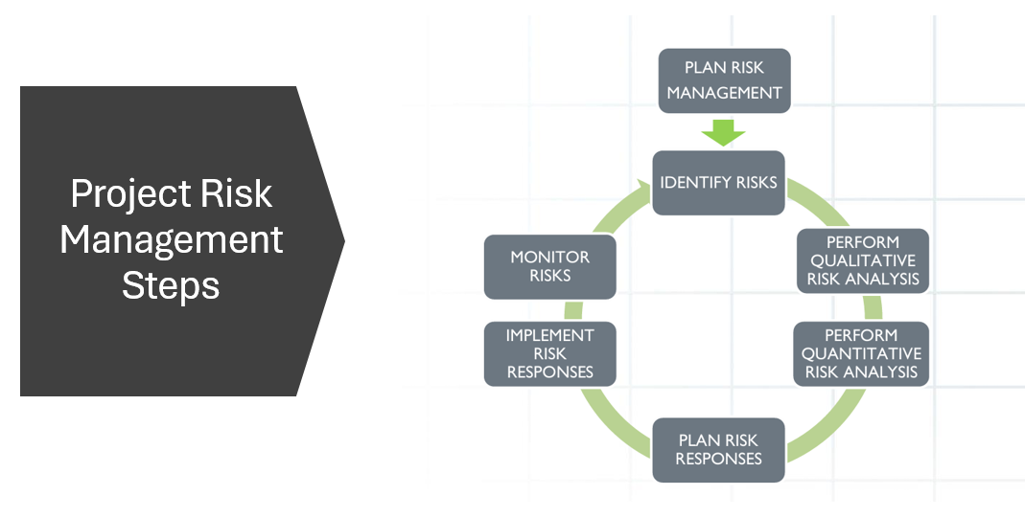
Risk Management Process

Slide 22
Risk Management Process
Plan Risk Management
Defines how to conduct risk management activities.
Outputs:
Risk Management Plan
Example: Decide risk categories, probability scales, and reporting format.
Identify Risks
Identifying all possible risks that may affect the project.
Tools:
Brainstorming
Checklists
Expert judgment
SWOT analysis
Example: Identify risk of API failure during system integration.
Output:
Risk Register (initial)

Slide 23
SWOT Analysis
SWOT stands for:
S – Strengths
W – Weaknesses
O – Opportunities
T – Threats
It is a strategic analysis technique used to evaluate internal and external factors that can affect a project or organization.
In PMBOK Project Risk Management, SWOT analysis is used during the Identify Risks process to identify:
Negative risks (Threats) → things that may harm the project
Positive risks (Opportunities) → things that may benefit the project
Classification:
Strengths & Weaknesses → Internal factors
Opportunities & Threats → External factors
Each SWOT factor is converted into specific, documented project risks and recorded in the Risk Register.

Slide 24
SWOT Analysis
SWOT Element | Role in Risk Identification
Strengths | May reduce risks or create opportunities
Weaknesses | Internal sources of project threats
Opportunities | Positive risks to exploit or enhance
Threats | External sources of negative risks

Slide 25
SWOT Analysis
Strengths (Internal – Positive)
Experienced software development team
Use of modern programming frameworks
Strong management and stakeholder support
Proven project management methodology
Good development and testing infrastructure
Weaknesses (Internal – Negative)
Limited cybersecurity expertise
Incomplete or unclear user requirements
Dependence on key technical resources
Limited experience with third-party integrations
Tight project schedule

Slide 26
SWOT Analysis
Opportunities (External – Positive)
Availability of cloud computing services
Automated testing and DevOps tools
Growing online market demand
Reusable open-source components
Vendor discounts for cloud services
Threats (External – Negative)
Cybersecurity attacks and data breaches
Frequent changes in technology
Changes in data privacy regulations
Third-party API or vendor failures
Increased competition and market pressure

Slide 27
Risk Management Process
Perform Qualitative Risk Analysis
Prioritizing risks based on probability and impact.
Techniques:
Probability–Impact Matrix
Risk categorization
Example: High probability + high impact → Critical risk
Perform Quantitative Risk Analysis
Numerical analysis of risk impact.
Techniques:
Expected Monetary Value (EMV)
Monte Carlo simulation
Example: Risk may cause ₹5,00,000 loss with 20% probability.

Slide 28
Qualitative Risk Analysis (QRA)
Qualitative Risk Analysis is the process of prioritizing risks based on their probability of occurrence and impact on project objectives (scope, time, cost, quality, etc.) using subjective assessment techniques.
It is usually done first, because it’s faster and helps focus on high-priority risks for further quantitative analysis.
Steps in Qualitative Risk Analysis
Risk Identification
Collect all risks from Risk Register (often using tools like SWOT, brainstorming, checklists).
Risk Probability Assessment
Assess the likelihood of each risk occurring.
Example scale: High / Medium / Low or 0–1 probability.
Risk Impact Assessment
Assess the effect of each risk on project objectives.
Example scale: High / Medium / Low or numerical score (1–5).
Risk Prioritization
Combine probability and impact to calculate risk rating.
Tools: Probability-Impact Matrix (P-I Matrix).
Risk Categorization (Optional)
Group risks by source or type (technical, financial, external, organizational).
Update Risk Register
Document risk score, priority, and notes for next steps.

Slide 29
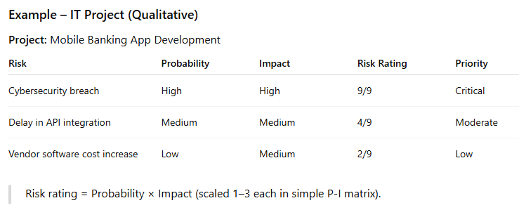
Qualitative Risk Analysis (QRA)
Types of Qualitative Risk Analysis Techniques
Probability-Impact Matrix
Risk Data Quality Assessment
Risk Urgency Assessment
Expert Judgment
Categorical (Risk Breakdown Structure) analysis

Slide 30
Quantitative Risk Analysis (QuanRA)
Quantitative Risk Analysis is the numerical analysis of the effect of identified risks on project objectives, usually using statistical, mathematical, or simulation techniques.
It provides a numerical estimate of potential cost, time, or performance impact.
Steps in Quantitative Risk Analysis
Input Risk Data
Use risks prioritized from Qualitative Risk Analysis.
Assign Numerical Values
Probability: 0–1 or %
Impact: monetary value, duration, or other measurable metric
Model Risk Effects
Methods: Expected Monetary Value (EMV), Monte Carlo simulation, sensitivity analysis, decision tree analysis.
Analyze Risk Exposure
Calculate Overall Project Risk Exposure = Σ (Probability × Impact)
Prioritize Risks Based on Numerical Impact
Rank risks that have the highest quantitative effect.
Document Results in Risk Register
Include numeric impact, probability, risk exposure, and recommended response.

Slide 31
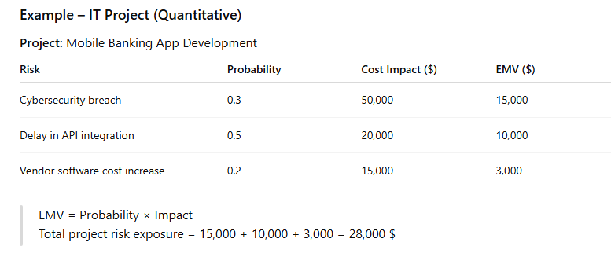
Quantitative Risk Analysis (QuanRA)

Slide 32
Risk Management Process
6.5 Plan Risk Responses
Developing actions to address risks.
Example: Hiring backup developers to handle attrition risk.
6.6 Implement Risk Responses
Executing planned risk response actions.
6.7 Monitor Risks
Tracking identified risks and identifying new risks.
Example: Weekly risk review meetings.

Slide 33
Risk Register
Records identified risks, their characteristics, and planned responses throughout the project lifecycle.
It is a living document updated continuously.
7.2 Components of a Risk Register
Risk ID
Risk Description
Risk Category
Probability
Impact
Risk Priority
Risk Owner
Response Strategy
Status

Slide 34
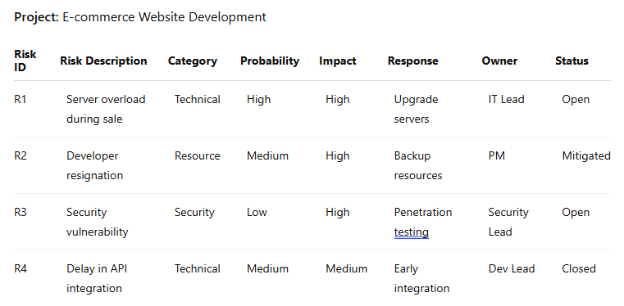
Risk Register

Slide 35
Project Evaluation - Performance Evaluation
Project evaluation measures how well the project is performing and whether objectives are met.
Uses Earned Value Management (EVM).
Key Metrics:
Planned Value (PV)
Earned Value (EV)
Actual Cost (AC)
Schedule Performance Index (SPI)
Cost Performance Index (CPI)
Example:
PV = ₹10,00,000
EV = ₹8,00,000
AC = ₹9,00,000
CPI = EV / AC = 0.89 → Over budget
SPI = EV / PV = 0.8 → Behind schedule
👉 Corrective actions required.

Slide 36
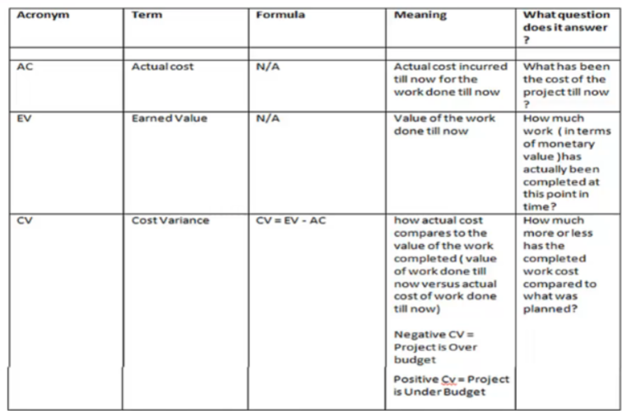
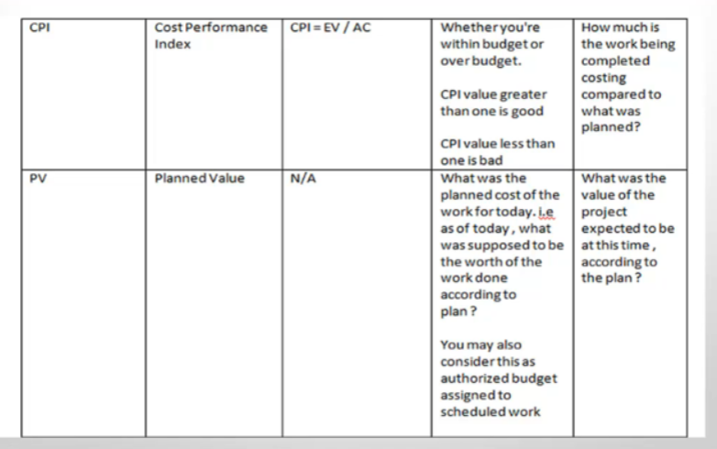
Performance Evaluation

Slide 37
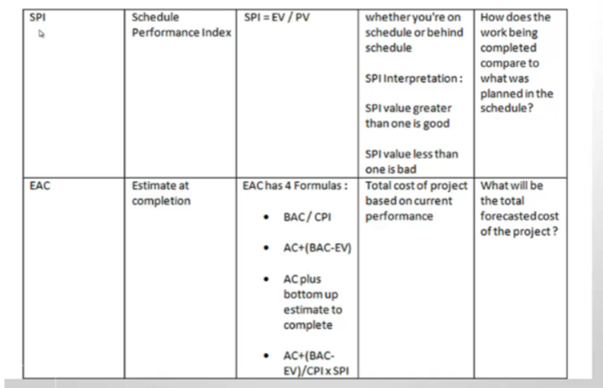
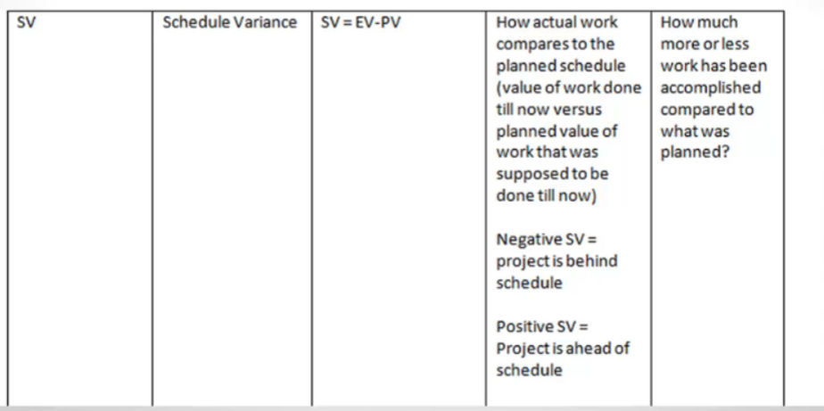
Performance Evaluation

Slide 38
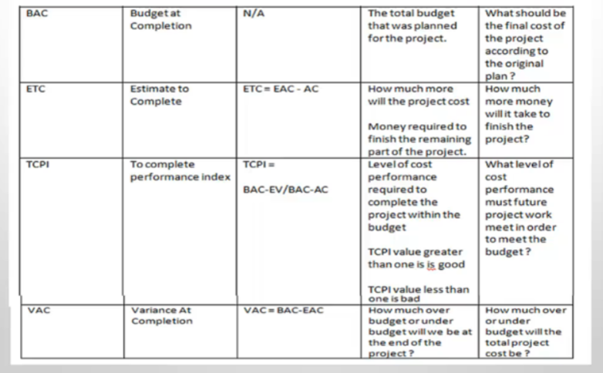
Performance Evaluation

Slide 39
Performance Evaluation – Burndown Chart
A Burn Down Chart is a graphical tool used in Agile project management to track:
Remaining work (tasks, story points, or hours)
Over time (usually days or sprints)
It helps monitor project progress and evaluate team performance against the plan.
Key Idea:
X-axis → Time (days, sprints)
Y-axis → Remaining work (effort units, story points, hours)
Line → Shows how work is “burning down” to zero

Slide 40
Project Evaluation - Quality Evaluation
Checks whether deliverables meet quality standards.
Tools:
Quality audits
Control charts
Inspections
Example: In a construction project:
Concrete strength required: 30 MPa
Test result: 27 MPa
👉 Rework required to meet standards.

Slide 41
Project Evaluation - Scope Evaluation
Ensures deliverables meet stakeholder requirements.
Example: Client requested:
Website with payment gateway
Mobile responsive design
If mobile responsiveness is missing: 👉 Deliverable is not accepted.

Slide 42
Scope Evaluation
Scope Evaluation is the process of assessing whether the project’s deliverables meet the defined project scope and requirements.
Purpose:
Ensure deliverables match scope statement and WBS
Identify scope creep (unauthorized changes)
Confirm completion of milestones and deliverables
Support stakeholder approval and acceptance

Slide 43
Scope Evaluation
2. Steps to Perform Scope Evaluation (PMBOK Approach)
Review Project Scope Statement & WBS
Understand all approved deliverables, requirements, and exclusions.
Check Deliverables Against Requirements
Verify if each deliverable meets quality and acceptance criteria.
Conduct Scope Verification
Use formal reviews, inspections, walkthroughs, or audits with stakeholders.
Identify Scope Changes
Detect unauthorized work, incomplete tasks, or missing requirements.
Document Findings
Record discrepancies, deviations, and approved changes in scope documentation.
Obtain Formal Acceptance
Stakeholders formally approve deliverables, ensuring closure of scope for the phase/project.
Update Project Records
Update project management plan, scope baseline, and change log as needed.

Slide 44
Scope Evaluation
3. Tools & Techniques for Scope Evaluation
Inspections / Reviews / Audits
Checklists based on scope baseline
Variance analysis (planned vs actual deliverables)
Performance measurement (e.g., Earned Value metrics)
Expert judgment

Slide 45
Project Evaluation - Schedule Evaluation
Evaluates project progress against the schedule baseline.
Tools:
Gantt charts
Milestone reviews
Critical Path Method (CPM)
Example: If testing was planned for 2 weeks but takes 4 weeks: 👉 Schedule variance identified and corrective planning done.

Slide 46
Post-Project Evaluation
Benefits Realization Analysis
Checks whether expected benefits are achieved.
Example: ERP project expected:
20% reduction in operating cost
After 1 year:
Actual reduction: 15%
👉 Partial success; improvement opportunities identified.

Slide 47
Post-Project Evaluation
Lessons Learned Evaluation
Identifies:
What went well
What went wrong
What can be improved
Example: Lesson learned:
Early stakeholder involvement reduced change requests
👉 Documented for future projects.

Slide 48
Post-Project Evaluation
3.3 Customer Satisfaction Evaluation
Measures stakeholder satisfaction.
Tools:
Surveys
Feedback forms
Interviews
Example: Client rates project:
Quality: 4/5
Schedule: 3/5
Communication: 5/5

Slide 49
Project Analysis and Evaluation Framework
Project analysis is commonly divided into three major assessments:
Strategic Assessment
Technical Assessment
Economic (Financial) Assessment
3. Strategic Assessment
3.1 Meaning
Strategic assessment evaluates how well a project supports the organization’s vision, mission, and long-term strategy.
PMBOK emphasizes that projects should deliver business value, not just outputs.

Slide 50
Project Analysis and Evaluation Framework
3.2 Key Strategic Questions
Does the project align with organizational goals?
Does it provide competitive advantage?
Is it aligned with regulatory, social, or environmental requirements?
Does it support growth, innovation, or sustainability?
3.3 Strategic Assessment Tools
SWOT Analysis
PESTLE Analysis
Porter’s Five Forces
Balanced Scorecard
Strategic Alignment Matrix

Slide 51
Project Analysis and Evaluation Framework
3.4 Example
Organization Goal: Expand digital services
Project A: Develop a mobile banking application Project B: Renovate office buildings
Strategic Evaluation:
Project A supports digital transformation and customer reach
Project B improves infrastructure but does not directly support strategy
Conclusion: Project A scores higher strategically.

Slide 52
Technical Assessment
Technical assessment evaluates whether the project is technically feasible using available technology, skills, infrastructure, and time.
4.2 Key Technical Factors
Availability of technology
Technical complexity
Resource skills and expertise
Integration with existing systems
Technical risks
Compliance with standards

Slide 53
Technical Assessment
4.3 Technical Assessment Questions
Can the project be implemented with current technology?
Are skilled resources available?
Is the technology proven or experimental?
What are the technical risks?
4.4 Example
Project: Implement an AI-based customer support system
Required AI expertise is limited
Existing IT systems require integration
Technology is emerging but proven
Assessment Result: Technically feasible with moderate risk and training requirements.

Slide 54
Economic (Financial) Assessment
Economic assessment evaluates whether the financial benefits outweigh the costs over the project life cycle.
This is a key component of the Business Case in PMBOK.
5.2 Components of Economic Assessment
Initial investment cost
Operating and maintenance costs
Tangible and intangible benefits
Project life span
Time value of money
Risk and uncertainty

Slide 55
Economic (Financial) Assessment
6. Cost–Benefit Evaluation Techniques
These techniques are used to compare and select projects based on financial performance.

Slide 56
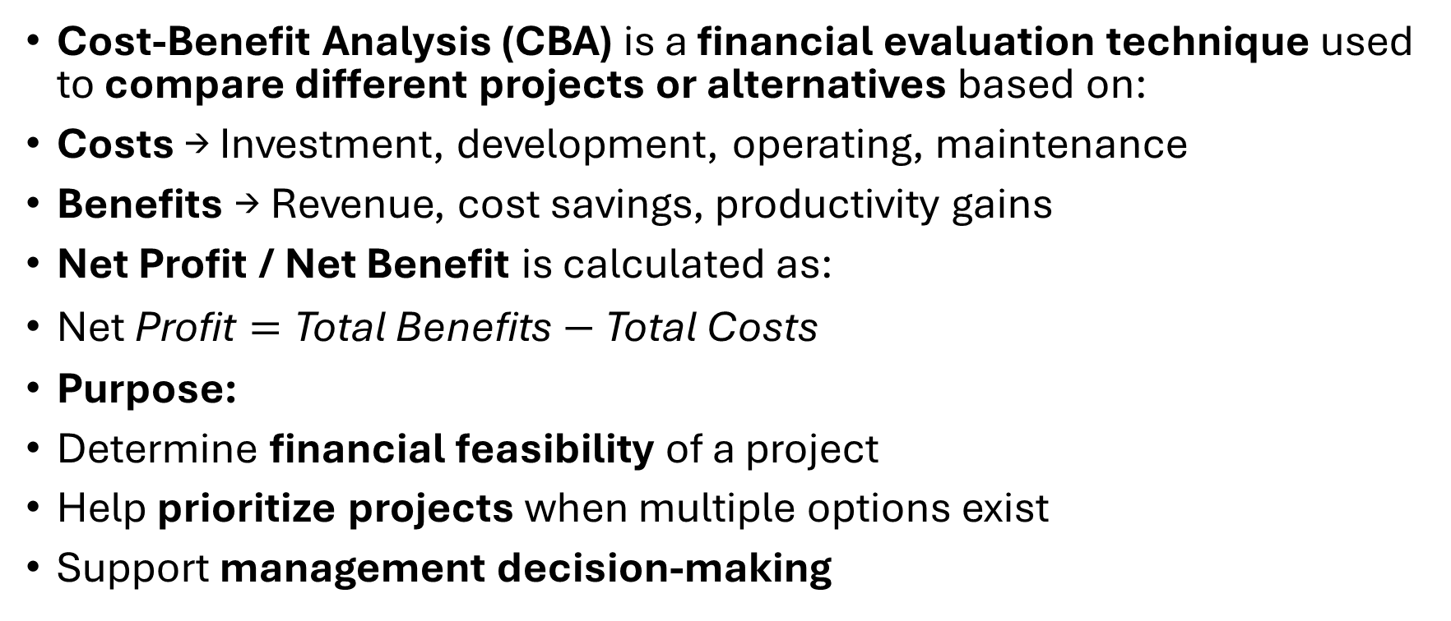
Comparison of projects based on cost benefit evaluation
Cost-Benefit Analysis (CBA) is a financial evaluation technique used to compare different projects or alternatives based on:
Costs → Investment, development, operating, maintenance
Benefits → Revenue, cost savings, productivity gains
Net Profit / Net Benefit is calculated as:
$\text{Net} \text{Profit}=\text{Total} \text{Benefits}−\text{Total} \text{Costs}$
Purpose:
Determine financial feasibility of a project
Help prioritize projects when multiple options exist
Support management decision-making

Slide 57
Cost-Benefit Evaluation Technique
2. Steps to Compare Projects Using Net Profit
List Alternatives / Projects
Identify all IT projects under consideration.
Estimate Costs for Each Project
Include development cost, hardware, software licenses, training, maintenance.
Estimate Benefits for Each Project
Revenue, cost savings, efficiency improvements, productivity gains.
Calculate Net Profit (Net Benefit)
Net Profit = Benefits − Costs
Rank Projects
Higher net profit → higher priority for implementation.
Consider Non-Financial Factors (Optional)
Strategic alignment, risk, regulatory compliance, customer satisfaction.

Slide 58
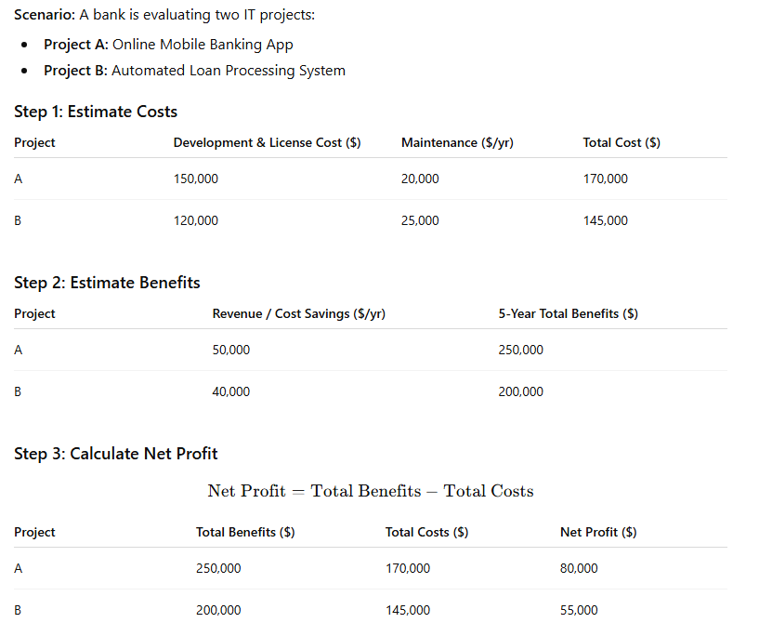
Example

Slide 59
Example
Step 4: Comparison & Decision
Project A → Higher net profit ($80,000) → preferred choice
Project B → Lower net profit ($55,000) → second priority
Interpretation: Even though Project B costs less, Project A provides higher financial benefit and is therefore prioritized.

Slide 60
Payback Period
The payback period is the time it takes for a project to recover its initial investment from its net benefits or cash inflows.
Payback Period (Years)=Annual Net BenefitsInitial Investment​
Purpose:
Evaluate the financial feasibility of a project
Compare projects with different costs and benefits
Helps management choose faster-returning investments
Key Concept:
Shorter payback period → faster recovery → lower risk
Longer payback period → delayed return → higher risk

Slide 61
Payback Period
2. Steps to Compare Projects Using Payback Period
List the projects / alternatives
Estimate the initial investment (costs)
Estimate annual benefits or savings
Calculate payback period for each project
If benefits vary yearly, cumulative cash flow is used
Rank the projects
Lower payback period → preferred choice
Consider other factors
Strategic alignment, risk, non-financial benefits

Slide 62
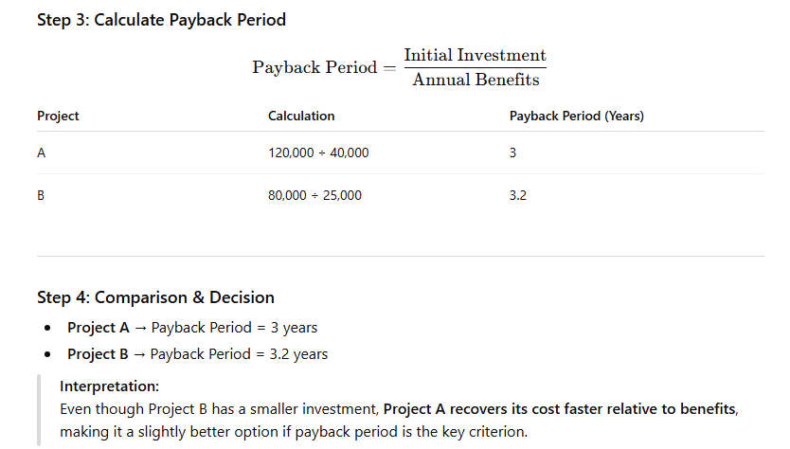
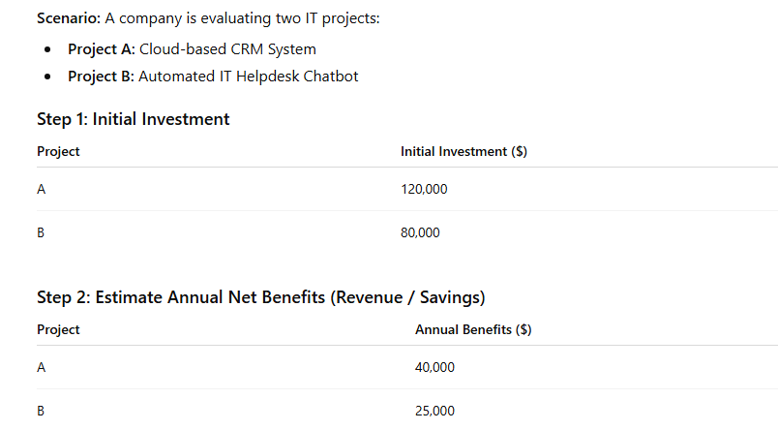
Example

Slide 63
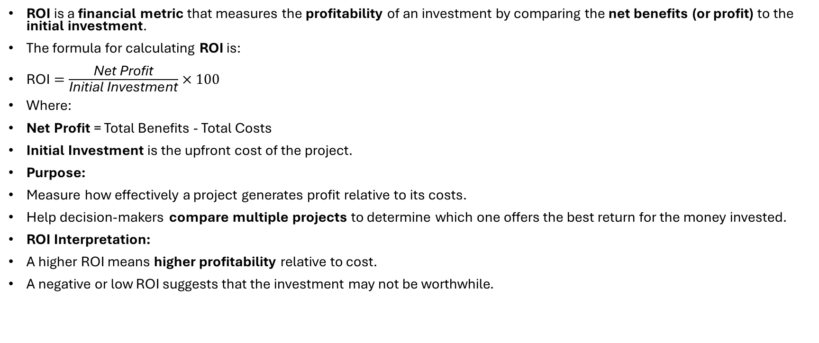
Return on Investment
ROI is a financial metric that measures the profitability of an investment by comparing the net benefits (or profit) to the initial investment.
The formula for calculating ROI is:
$\text{ROI}=\frac{\text{Net} \text{Profit}}{\text{Initial} \text{Investment}}×100$
Where:
Net Profit = Total Benefits - Total Costs
Initial Investment is the upfront cost of the project.
Purpose:
Measure how effectively a project generates profit relative to its costs.
Help decision-makers compare multiple projects to determine which one offers the best return for the money invested.
ROI Interpretation:
A higher ROI means higher profitability relative to cost.
A negative or low ROI suggests that the investment may not be worthwhile.

Slide 64
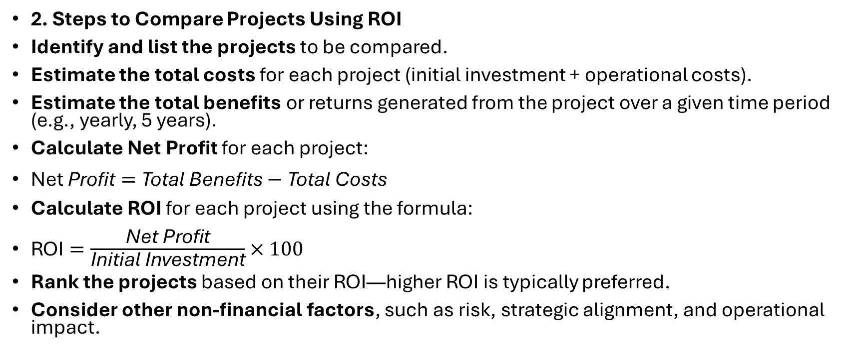
Return on Investment
2. Steps to Compare Projects Using ROI
Identify and list the projects to be compared.
Estimate the total costs for each project (initial investment + operational costs).
Estimate the total benefits or returns generated from the project over a given time period (e.g., yearly, 5 years).
Calculate Net Profit for each project:
$\text{Net} \text{Profit}=\text{Total} \text{Benefits}−\text{Total} \text{Costs}$
Calculate ROI for each project using the formula:
$\text{ROI}=\frac{\text{Net} \text{Profit}}{\text{Initial} \text{Investment}}×100$
Rank the projects based on their ROI—higher ROI is typically preferred.
Consider other non-financial factors, such as risk, strategic alignment, and operational impact.

Slide 65
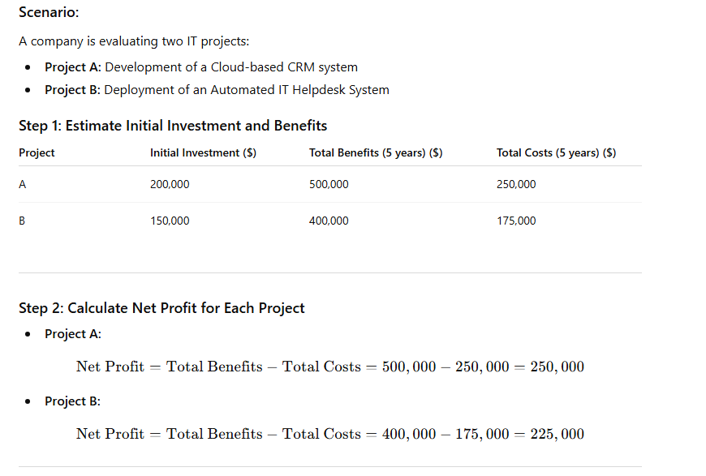
Example

Slide 66
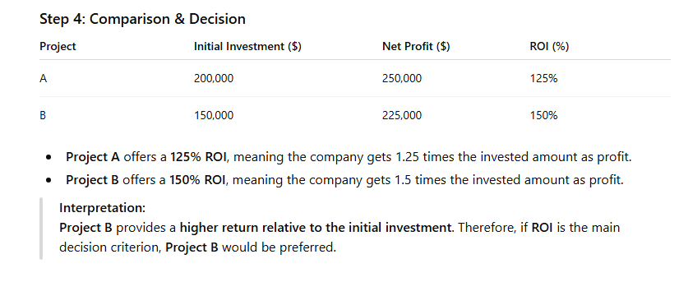
Example

Slide 67
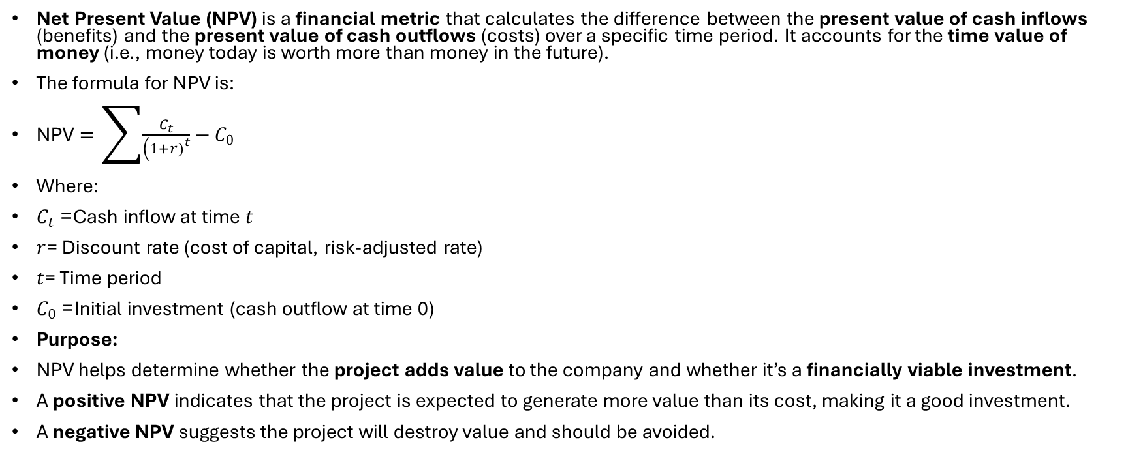
Net Present Value
Net Present Value (NPV) is a financial metric that calculates the difference between the present value of cash inflows (benefits) and the present value of cash outflows (costs) over a specific time period. It accounts for the time value of money (i.e., money today is worth more than money in the future).
The formula for NPV is:
$\text{NPV}=\sum{\frac{C_{t}}{\left(1+r{\left.)\right.}^{t}\right.}}−C_{0}$
Where:
$C_{t}$= Cash inflow at time $t$
$r$= Discount rate (cost of capital, risk-adjusted rate)
$t$= Time period
$C_{0}$= Initial investment (cash outflow at time 0)
Purpose:
NPV helps determine whether the project adds value to the company and whether it’s a financially viable investment.
A positive NPV indicates that the project is expected to generate more value than its cost, making it a good investment.
A negative NPV suggests the project will destroy value and should be avoided.

Slide 68
Net Present Value
Steps to Compare Projects Using NPV
Identify the projects to be compared.
Estimate the initial investment for each project.
Forecast the expected cash inflows (benefits) for each period (e.g., annually).
Choose the discount rate (r) based on the company’s cost of capital or risk-adjusted rate.
Calculate the present value of each cash inflow using the formula.
Subtract the initial investment to calculate the NPV.
Compare NPVs: Higher NPV is typically preferred.
Consider other non-financial factors: such as strategic alignment, risks, or customer impact.

Slide 69
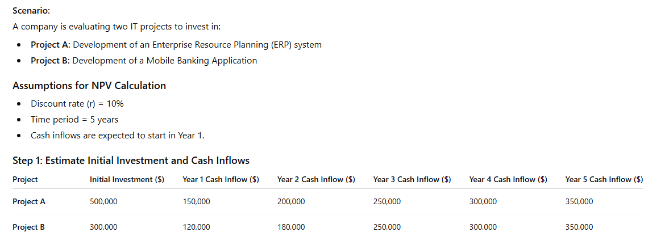
Example

Slide 70
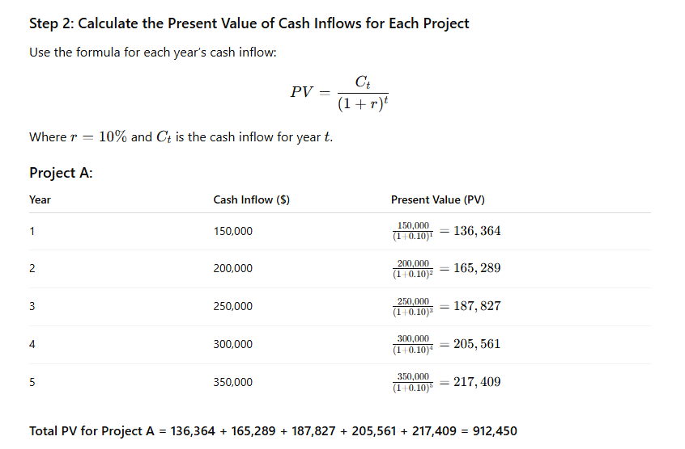
Example

Slide 71
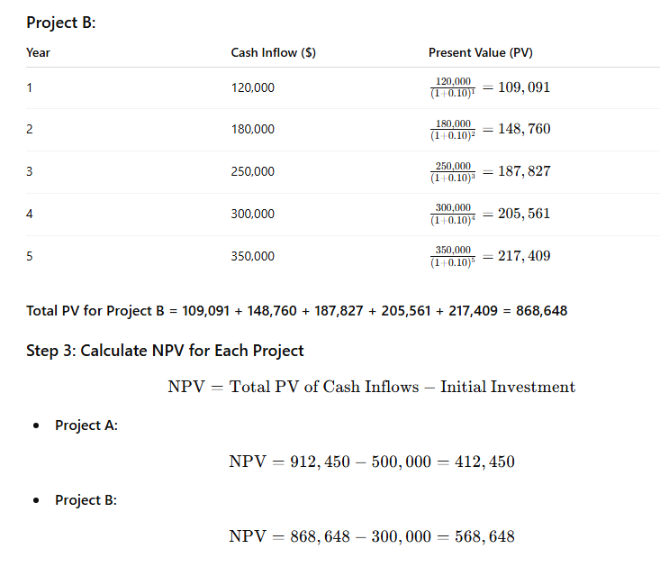
Example

Slide 72
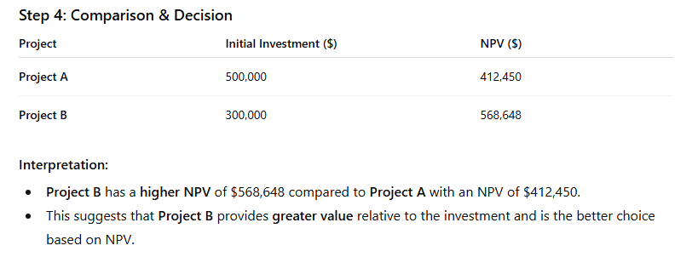
Example

Slide 73
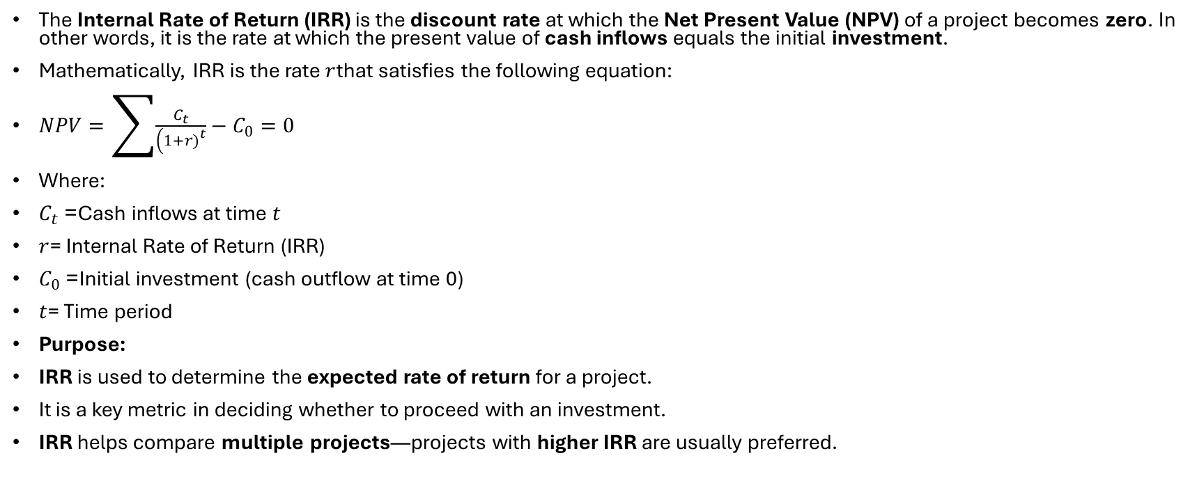
Internal Rate of Return
The Internal Rate of Return (IRR) is the discount rate at which the Net Present Value (NPV) of a project becomes zero. In other words, it is the rate at which the present value of cash inflows equals the initial investment.
Mathematically, IRR is the rate $r$that satisfies the following equation:
$NPV=\sum{\frac{C_{t}}{\left(1+r{\left.)\right.}^{t}\right.}}−C_{0}=0$
Where:
$C_{t}$= Cash inflows at time $t$
$r$= Internal Rate of Return (IRR)
$C_{0}$= Initial investment (cash outflow at time 0)
$t$= Time period
Purpose:
IRR is used to determine the expected rate of return for a project.
It is a key metric in deciding whether to proceed with an investment.
IRR helps compare multiple projects—projects with higher IRR are usually preferred.

Slide 74
Internal Rate of Return
2. Steps to Compare Projects Using IRR
Identify the projects to be compared.
Estimate the initial investment for each project.
Forecast the expected cash inflows (benefits) for each year or period.
Use an iterative process (trial and error or financial calculator) to find the IRR where the NPV = 0.
Compare IRRs of different projects.
If the IRR is higher than the required rate of return (hurdle rate) or cost of capital, the project is considered financially viable.
Consider other factors, such as risk, strategic alignment, and time horizons.

Slide 75
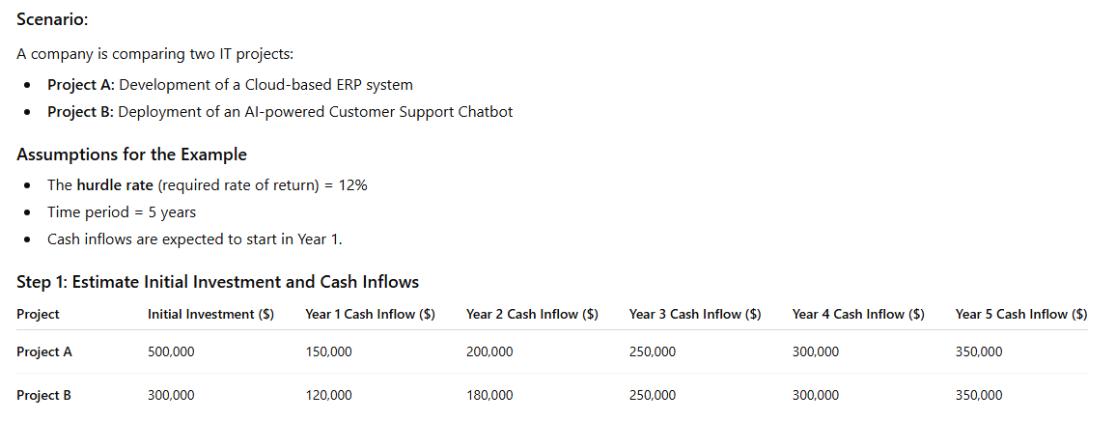
Example

Slide 76
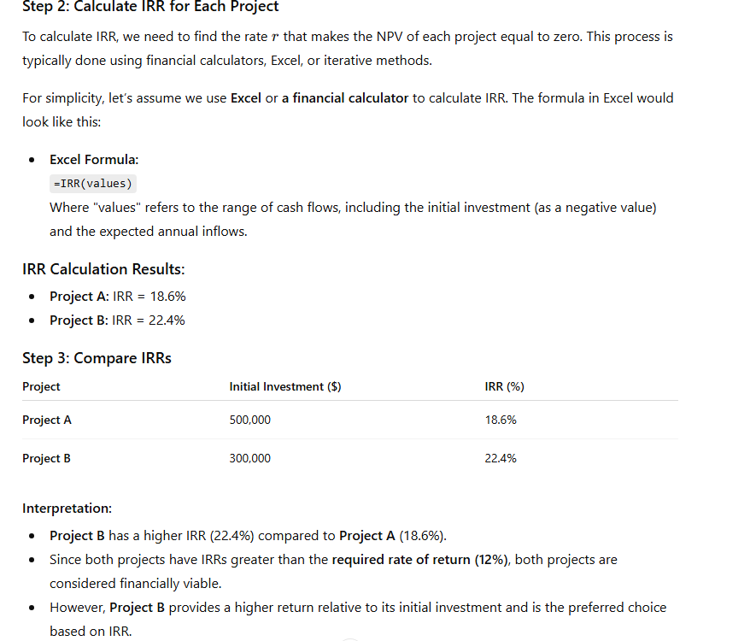
Example

